Slide 1
Hotel Reservation Analysis in SQL
Task 2

Slide 2
Problem Statement
The hotel industry relies on data to make informed decisions and provide a better guest experience. and we have to work with a hotel reservation dataset to gain insights into guest preferences,booking trends, and other key factors that impact the hotel's operations. We will use SQL to query andanalyze the data, as well as answer specific questions about the dataset.

Slide 3
Dataset Description
• Booking_ID: A unique identifier for each hotel reservation.
• no_of_adults: The number of adults in the reservation.
• no_of_children: The number of children in the reservation.
• no_of_weekend_nights: The number of nights in the reservation that fall on
weekends.
• no_of_week_nights: The number of nights in the reservation that fall on
weekdays.
• type_of_meal_plan: The meal plan chosen by the guests.
• room_type_reserved: The type of room reserved by the guests.
• lead_time: The number of days between booking and arrival.
• arrival_date: The date of arrival.
• market_segment_type: The market segment to which the reservation
belongs.
• avg_price_per_room: The average price per room in the reservation.
• booking_status: The status of the booking.

Slide 4
Hotel Reservation Analysis
1. What is the total number of reservations in the dataset?
2. Which meal plan is the most popular among guests?
3. What is the average price per room for reservations involving children?
4. How many reservations were made for the year 20XX (replace XX with the desired year)?
5. What is the most commonly booked room type?
6. How many reservations fall on a weekend (no_of_weekend_nights > 0)?
7. What is the highest and lowest lead time for reservations?
8. What is the most common market segment type for reservations?

Slide 5
Hotel Reservation Analysis
9. How many reservations have a booking status of "Confirmed"?
10. What is the total number of adults and children across all reservations?
11. What is the average number of weekend nights for reservations involving children?
12. How many reservations were made in each month of the year?
13. What is the average number of nights (both weekend and weekday) spent by guests for each room
type?
14. For reservations involving children, what is the most common room type, and what is the average
price for that room type?
15. Find the market segment type that generates the highest average price per room.

Slide 6
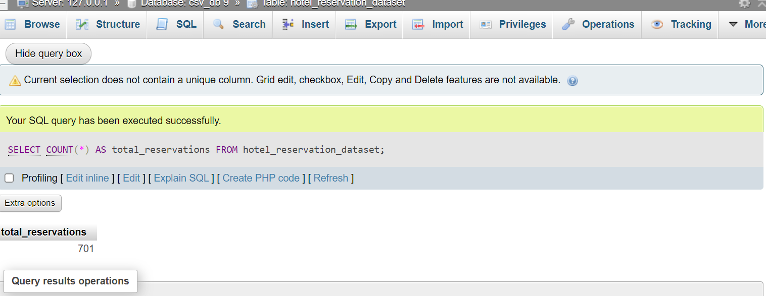
Hotel Reservation Analysis

Slide 7
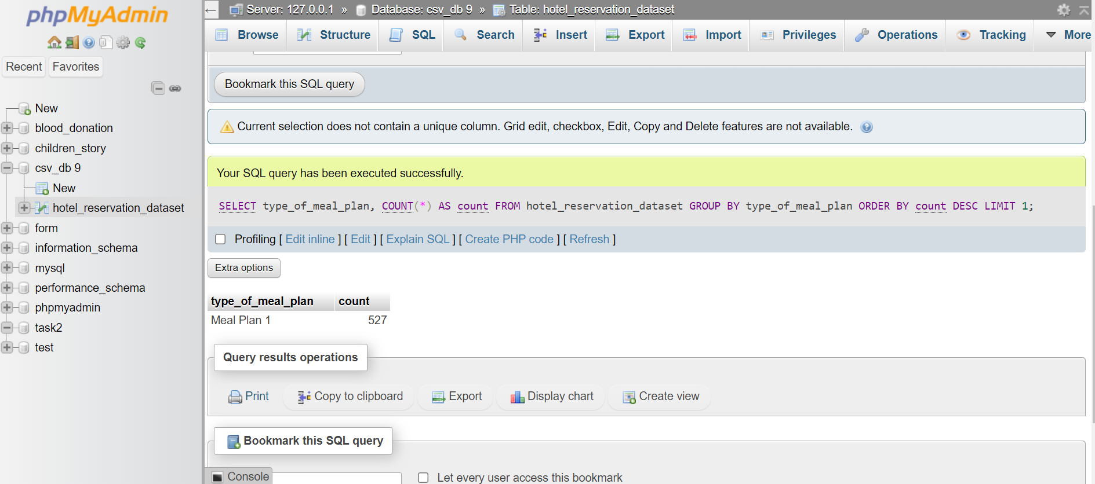
Hotel Reservation Analysis

Slide 8
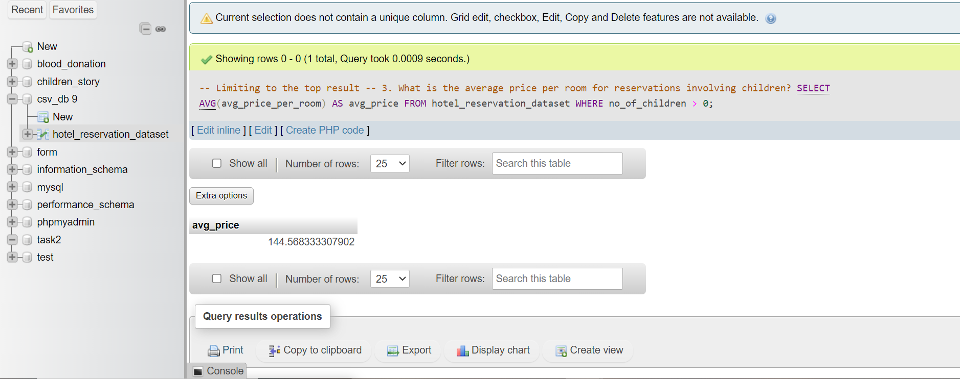
Hotel Reservation Analysis

Slide 9
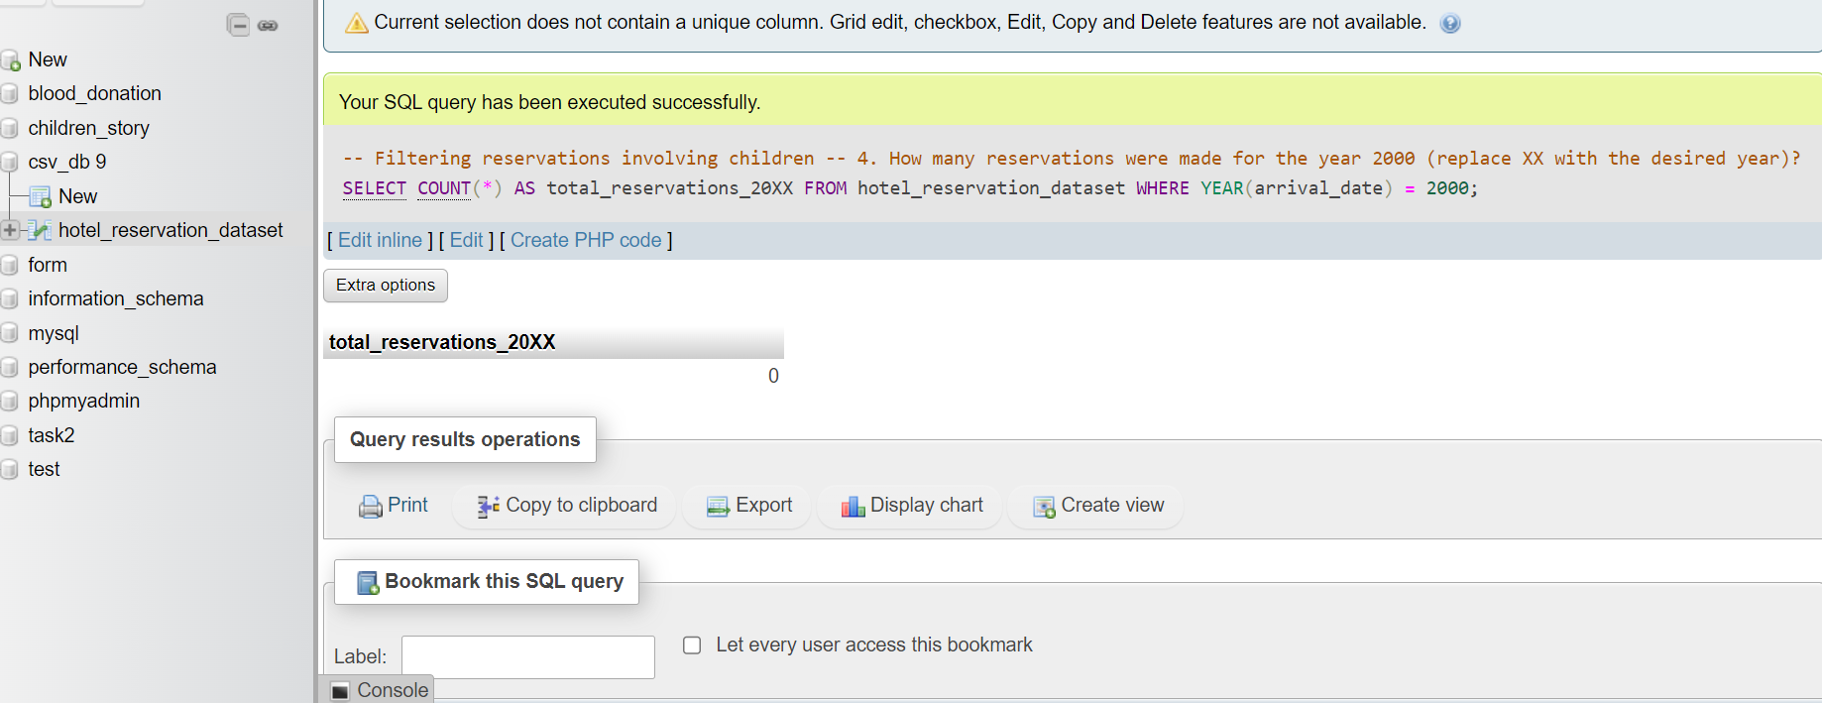
Hotel Reservation Analysis

Slide 10
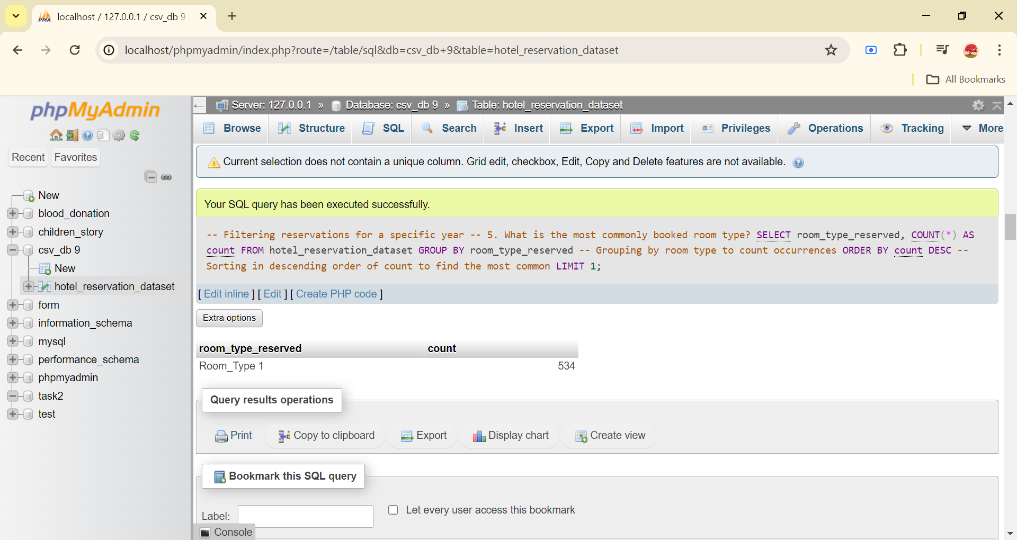
Hotel Reservation Analysis

Slide 11
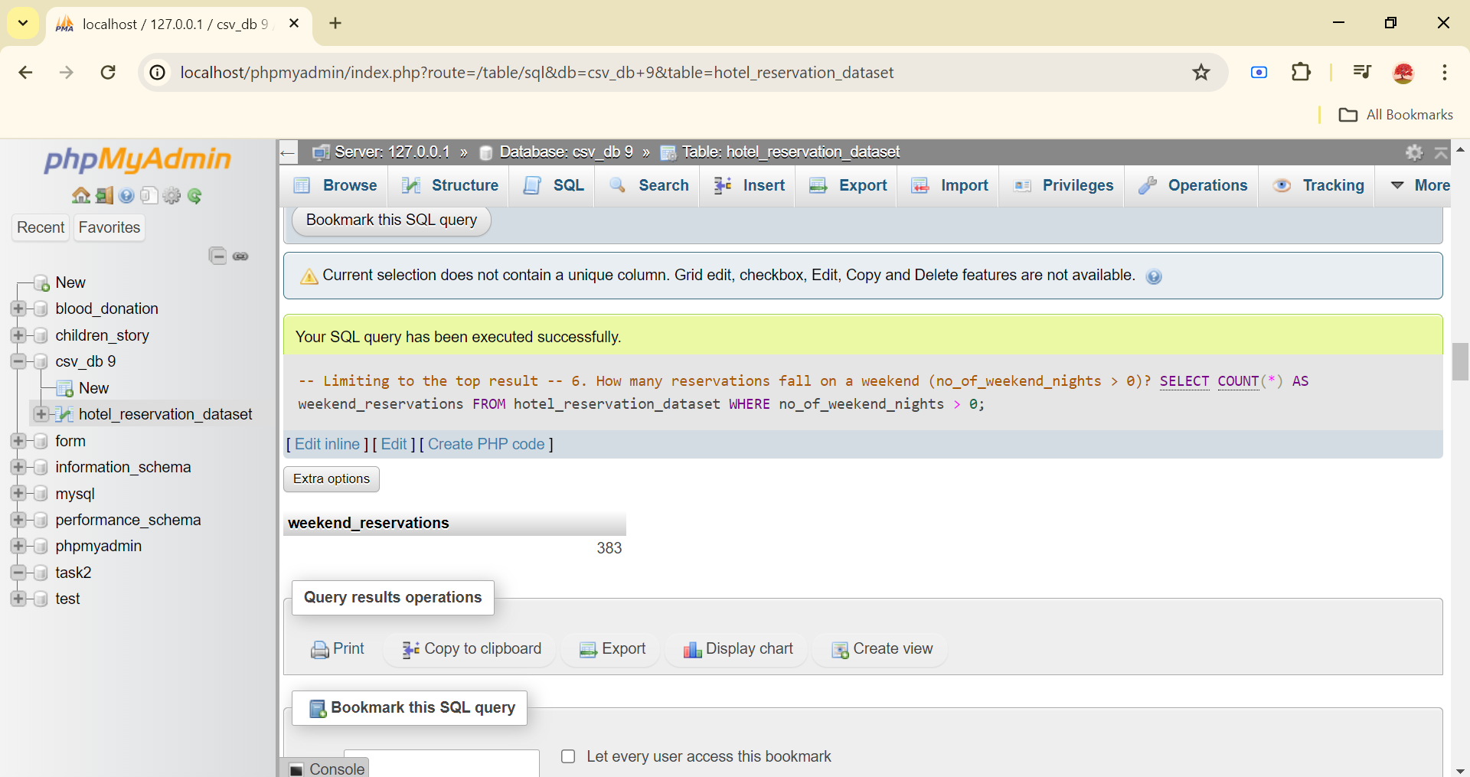
Hotel Reservation Analysis

Slide 12
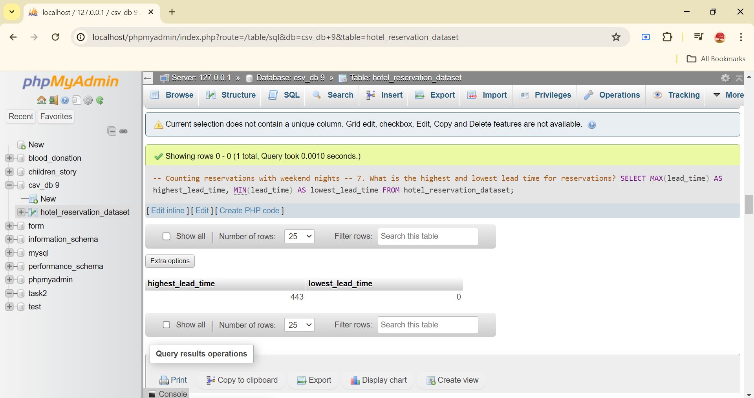
Hotel Reservation Analysis

Slide 13
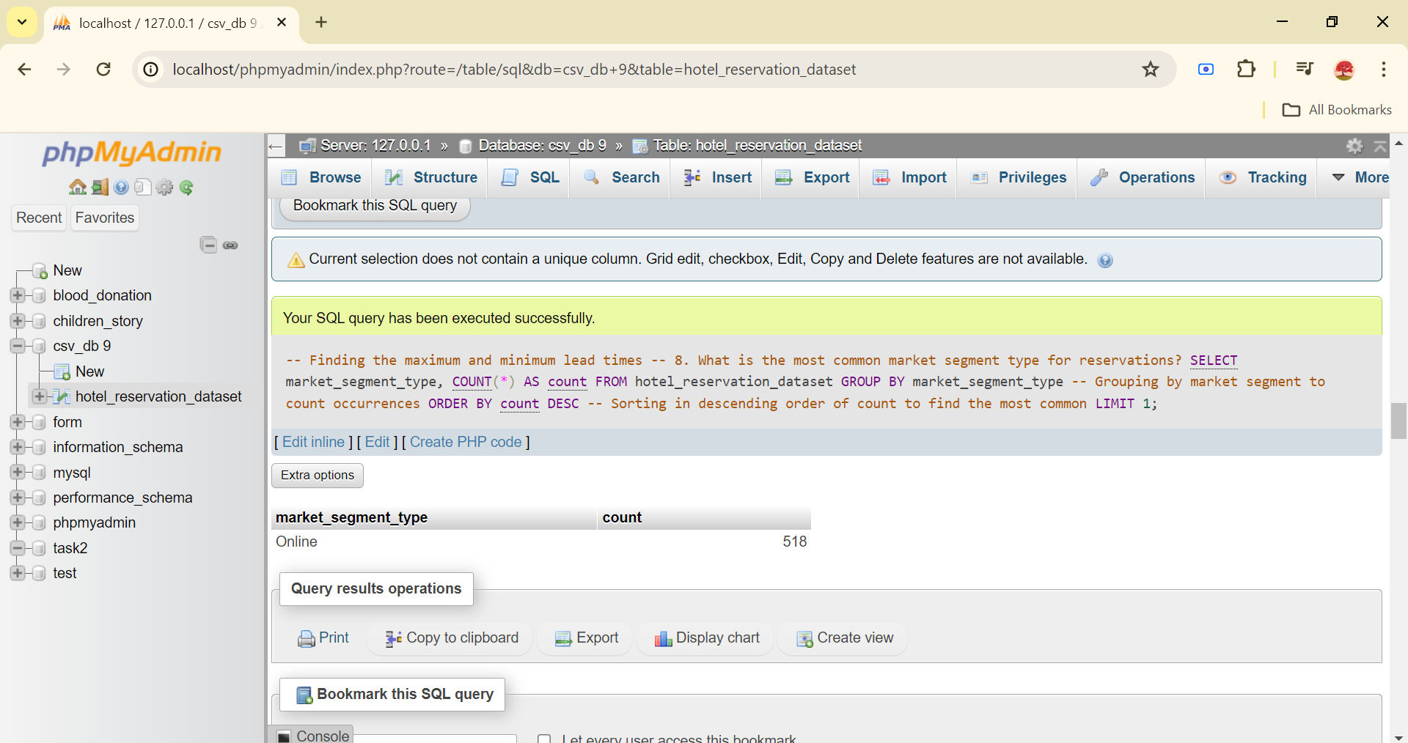
Hotel Reservation Analysis

Slide 14
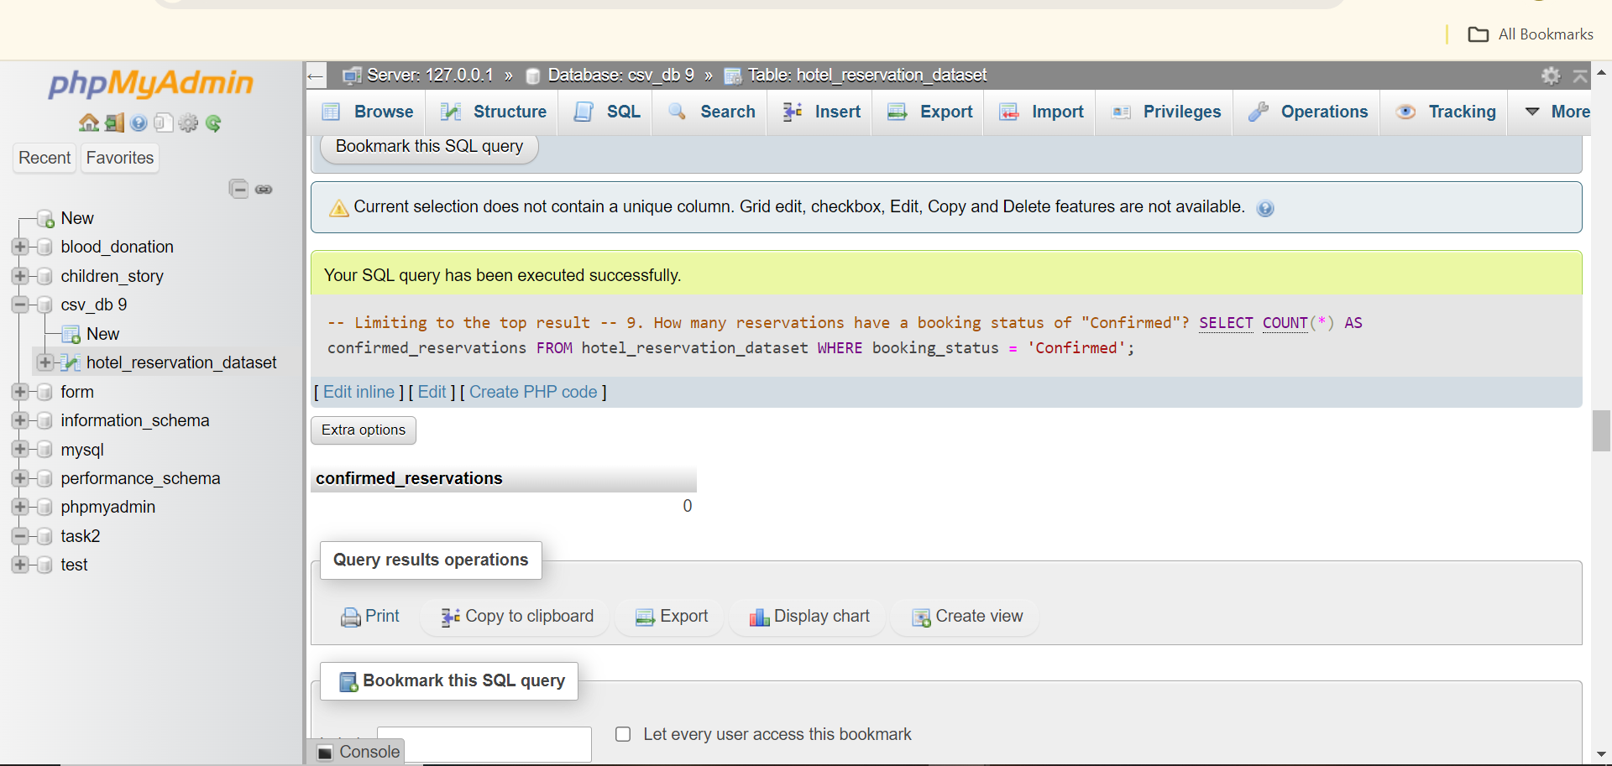
Hotel Reservation Analysis

Slide 15
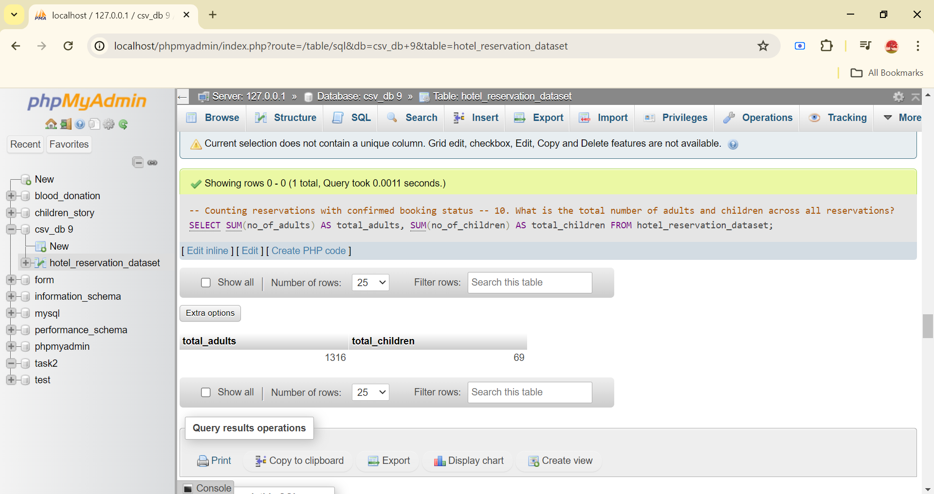
Hotel Reservation Analysis

Slide 16
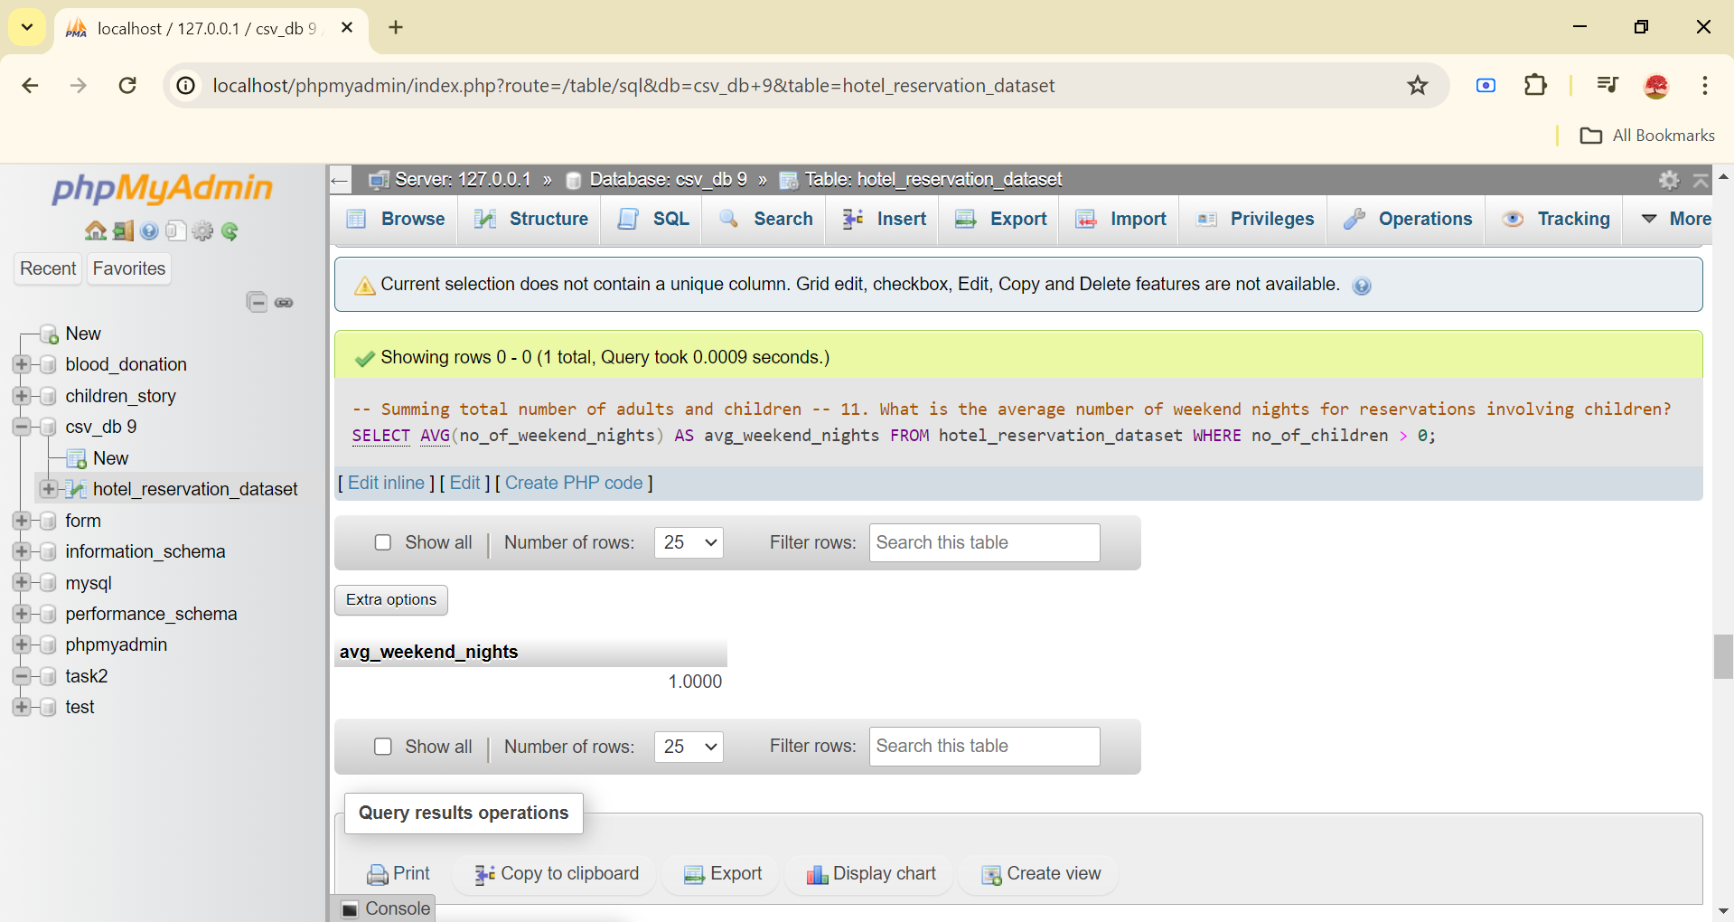
Hotel Reservation Analysis

Slide 17
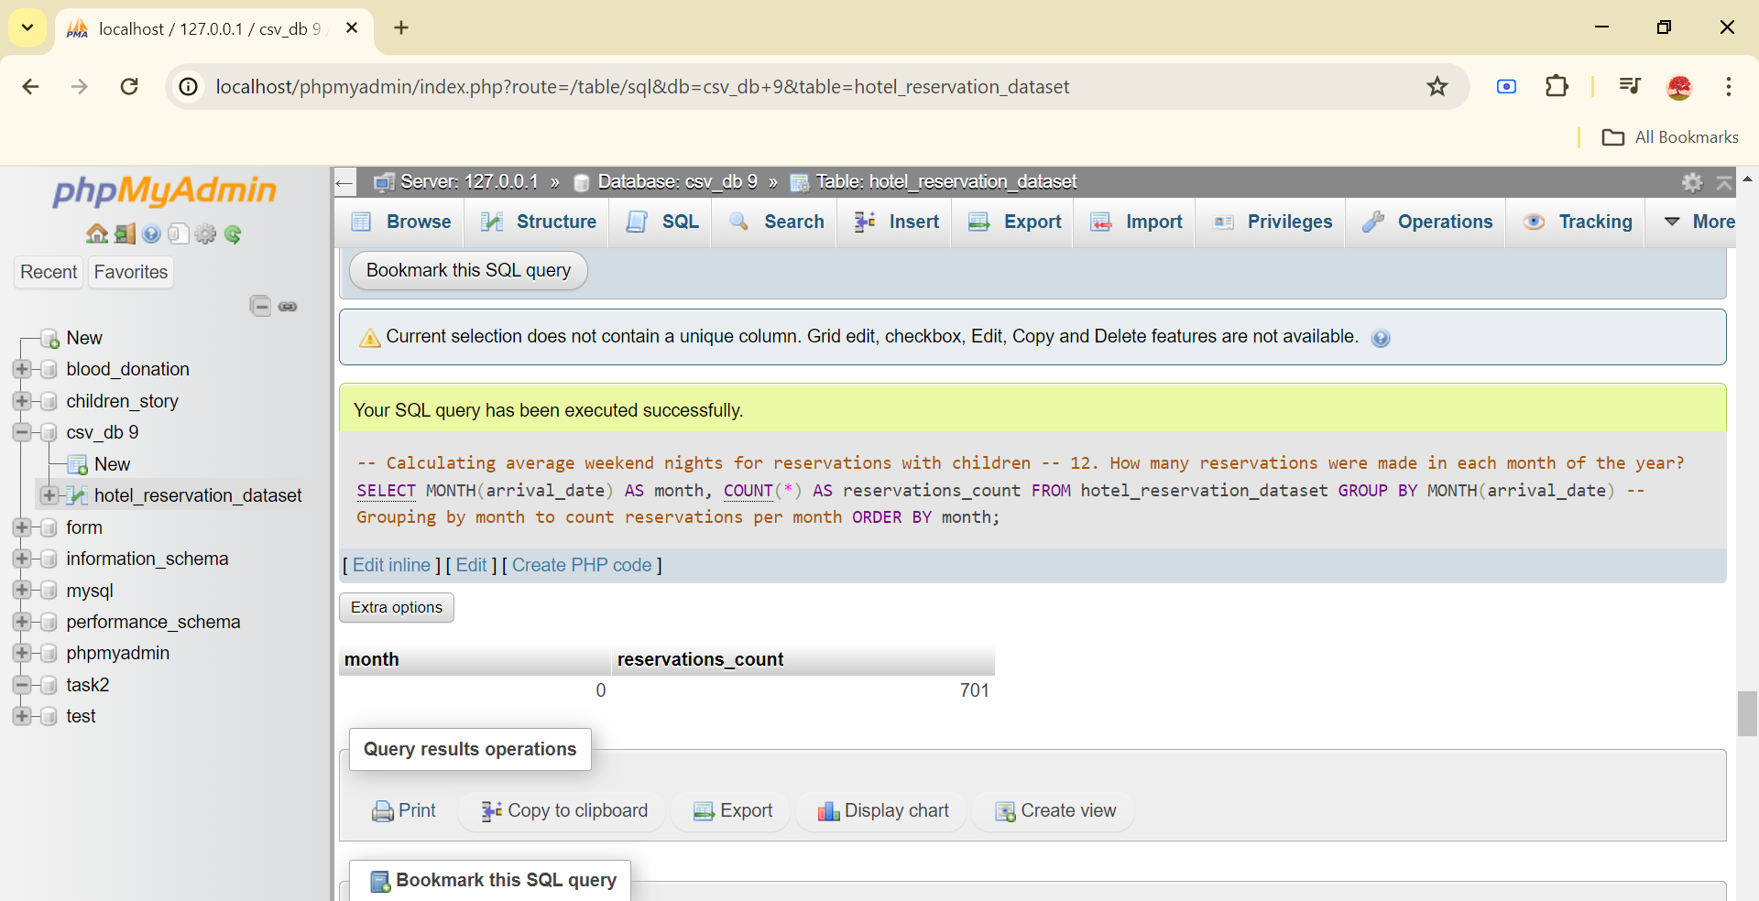
Hotel Reservation Analysis

Slide 18
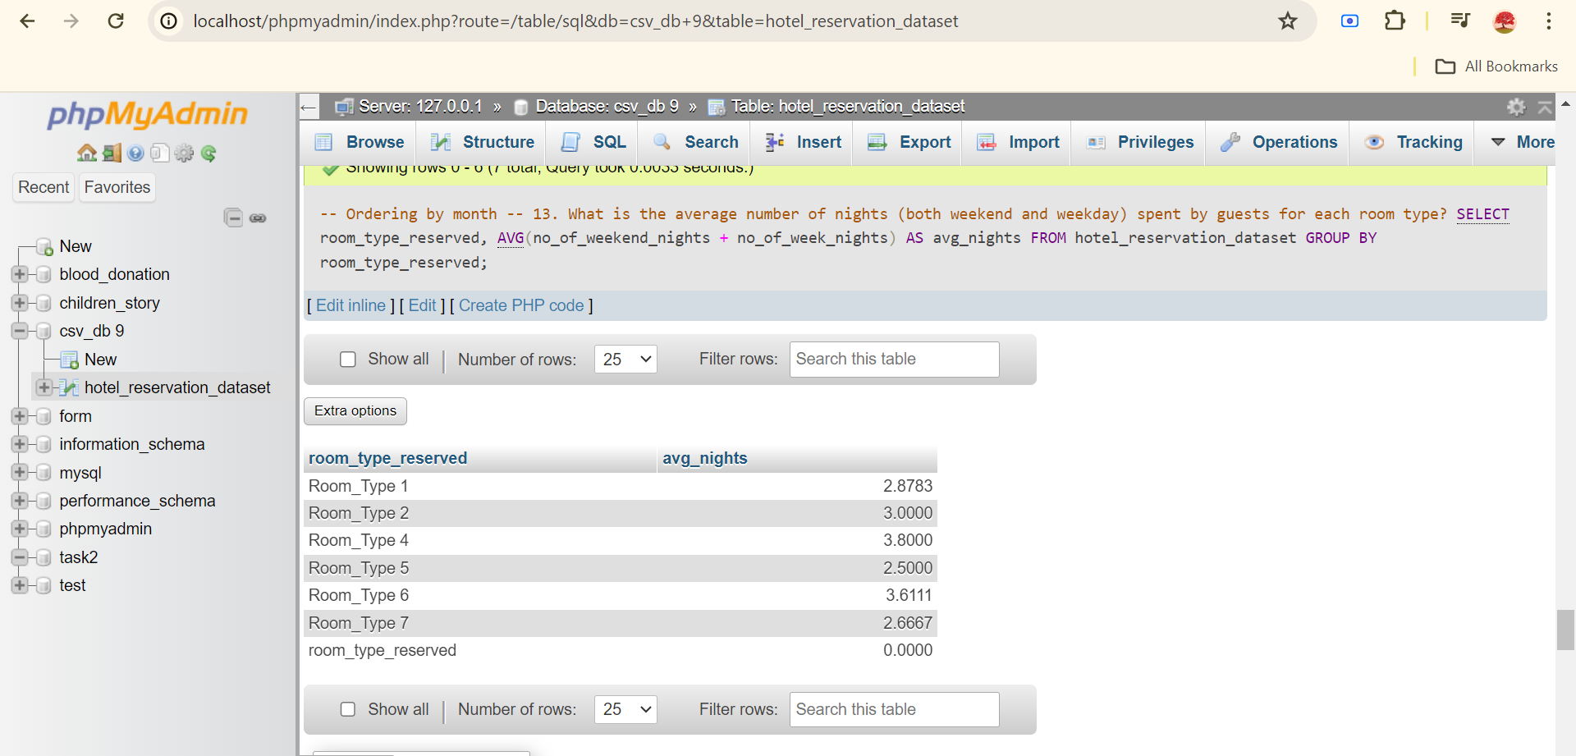
Hotel Reservation Analysis

Slide 19
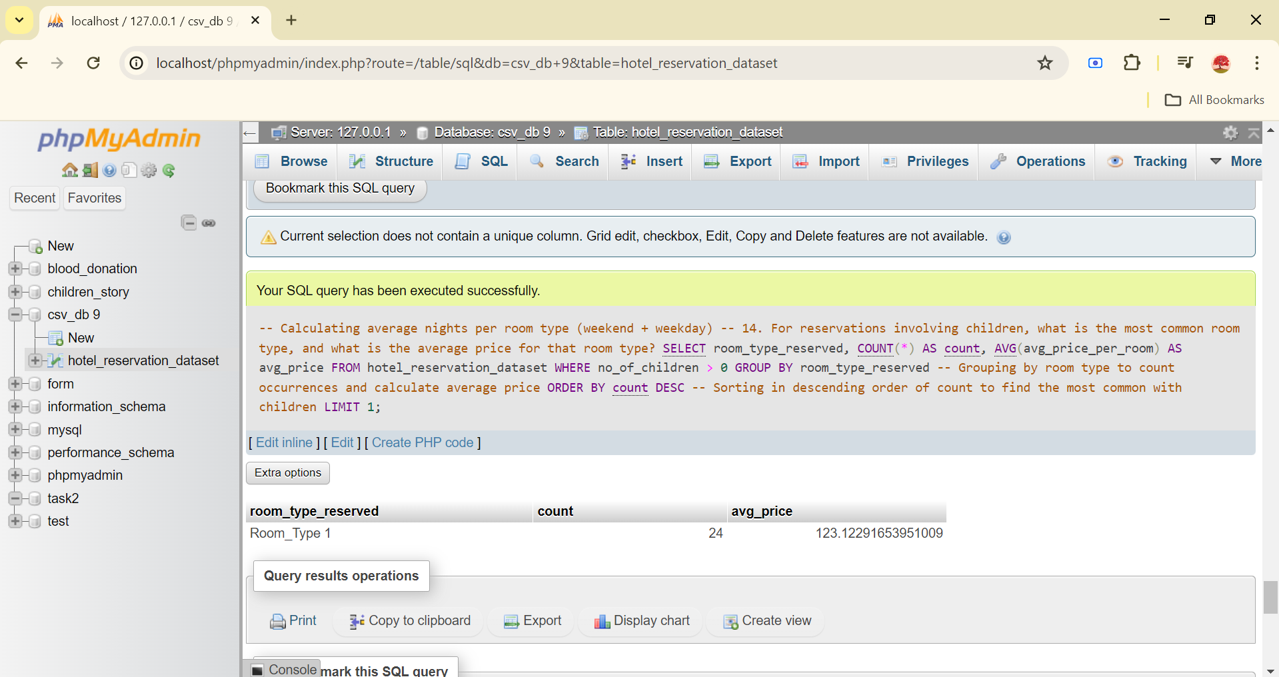
Hotel Reservation Analysis

Slide 20
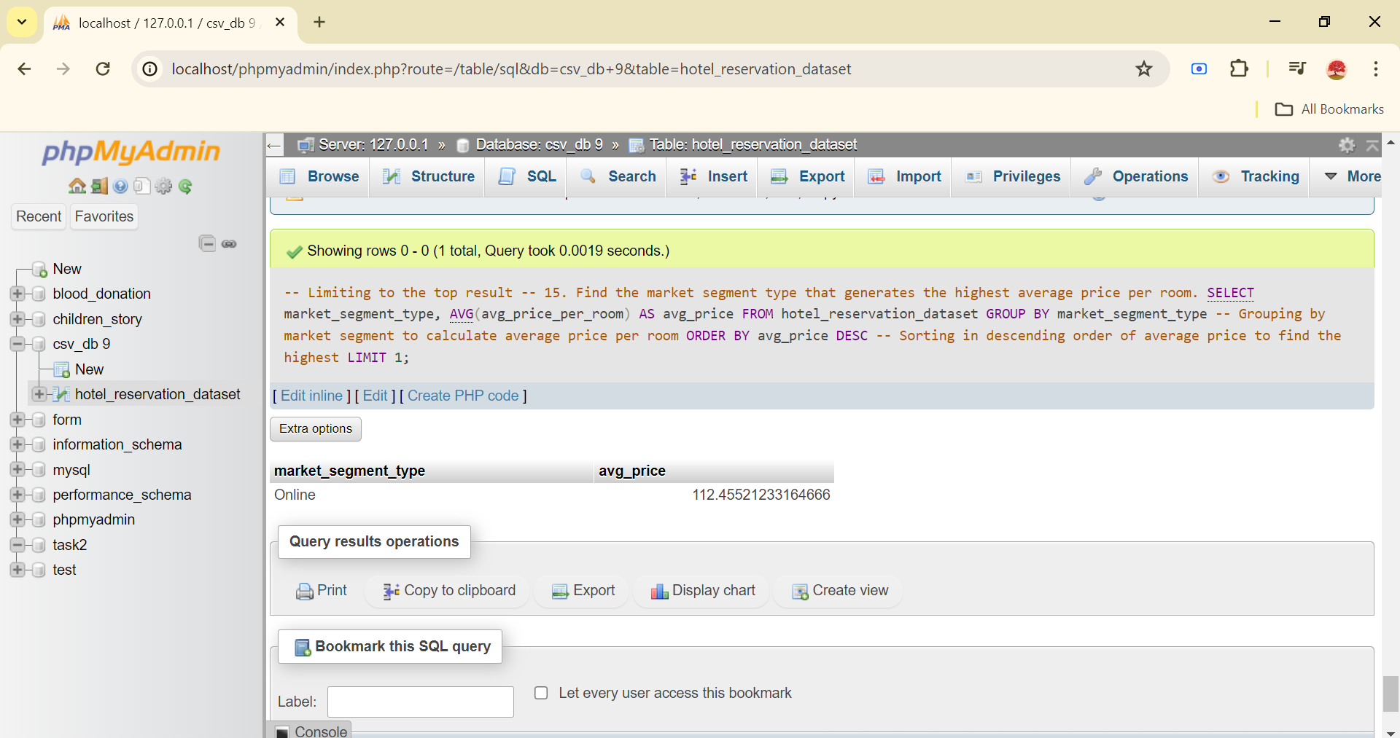
Hotel Reservation Analysis

Slide 21
All steps implementation are in source file.Kindly check it for practical Work.

Slide 22
Thank You!

